Slide 1
Recommendations for Big Mountain Resort

Slide 2
Problem Identification
The currently pricing strategy of Big Mountain Resort is based on the market average price.
There are limitations to this pricing strategy and there's a suspicion that Big Mountain is not capitalizing on its facilities as much as it could. It is possible that the existing facilities in the resort may support a higher ticket price.
To address this question, we investigated the data from 330 ski resorts that can be considered part of the same market share. Based on our findings, we evaluated several proposed strategies aimed at increasing the profit.

Slide 3
Recommendation and key findings
Here’s our findings. The most influential factors on ticket prices are:
Vertical change in elevation from the summit to the base
Number of runs
Number of fast four person chairs
Number of runs and the total area covered by snow making machine
Big Mountain Resort is already fairly high on the league charts for these facilities.
We recommend Big Mountain Resort to gradually close up to 5 least used runs while maintain the ticket price to be the same.

Slide 4

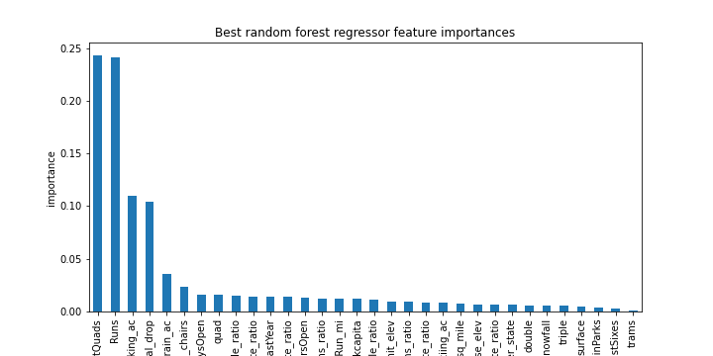



Feature Importance
Feature importance for our random forest model:

Slide 5

Modelling results and analysis
Two Models: Linear Regression, Random Forest
Evaluation Metric: MAE
Model Performance: Random Forest has better performance
Lastly we evaluated four suggested scenarios based on our random forest model.

Slide 6
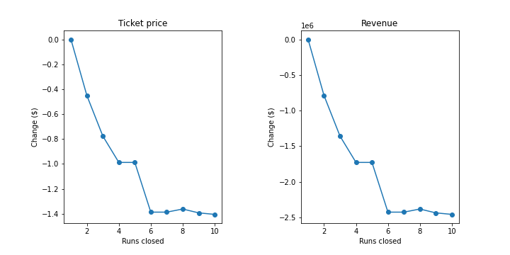
Modelling results and analysis
Evaluation on business strategies:
Close some least used runs. Our model suggests a decrease in price, especially when close more than 5 runs.

Slide 7
Modelling results and analysis
2. Add a run, increasing vertical drop by 150 feet and installing an additional chair lift. Our model suggests this will support an increase in ticket price by $1.08, which will increase the profit by $1895250. But given that the recently installed chairlift already cost $1540000, this strategy is unlikely to increase the net profit.
3. Same as the second, except we also add 2 acres of snow making. The outcome of this strategy is the same as the second. So this is unlikely to increase the net profit either.
4. Increase the longest run by 0.2 miles and guaranteeing its snow coverage by adding 4 acres of snow making capability. This has almost no influence on the ticket price.

Slide 8
Summary and conclusion
Based on our findings, we recommend Big Mountain Resort to gradually close up to 5 least used runs while maintain the current ticket price. Closing runs can reduce operating cost, our model also suggests that closing the first one or two runs won’t have much influence on ticket price. So one can gradually close runs and look at the market response to it. If the net profit increases, we can try closing more runs.

